Slide 1
Act 2
LATE PROTEROZOIC SEDIMENTATION AND RIFTING
Notes:
You may recall from previous lessons that the late Proterozoic marked a time of supercontinent rifting.

Slide 2
Grand Canyon Supergroup
basalt
Notes:
About 1.2 billion years ago, rapid subsidence brought on by rifting led to the return of sedimentation - represented by the Grand Canyon Supergroup. As is usually the case with rift-related rock formation, the Grand Canyon Supergroup contains continental and shallow marine sedimentary rocks as well as volcanic and shallow intrusive igneous rocks.

Slide 3
Block-faulted mountains
Normal faults
Notes:
Our study of the Basin and Range has shown us that rifting typically is associated with normal faulting and the formation of block faulted mountain ranges.

Slide 4
Grand Canyon Supergroup
Notes:
Subsequent erosion wore down the ranges such that the Grand Canyon Supergroup is preserved only within the somewhat tilted basins between the ranges. The broad, gently rolling Late Proterozoic landscape …

Slide 5
Act 3
“The DCM”
PALEOZOIC SEDIMENTATION
Notes:
… was buried under thick sediments during the Paleozoic period by which time the region had become a full-blown Divergent Continental Margin.

Slide 6
The Great Unconformity
Paleozoic
Proterozoic
Notes:
Thus a “Great Unconformity” separates the Proterozoic rocks from the Paleozoic DCM sedimentary rocks.

Slide 7
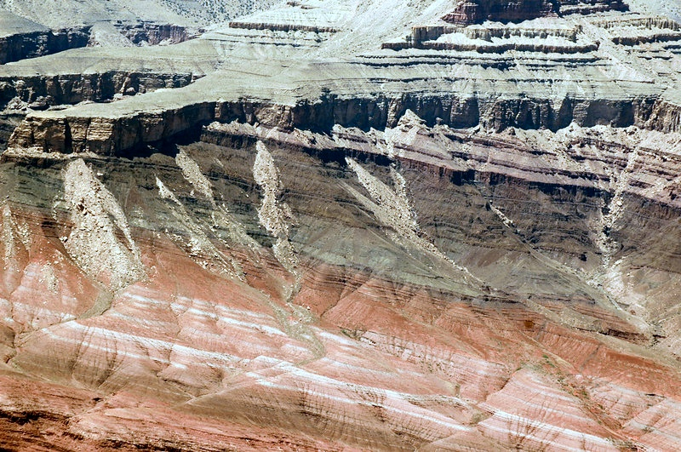
The Great Unconformity
Paleozoic
Proterozoic
Notes:
The Great Unconformity can be recognized by the difference in tilt between the gently-tilted Proterozoic strata and the near-horizontal Paleozoic strata above.

Slide 8
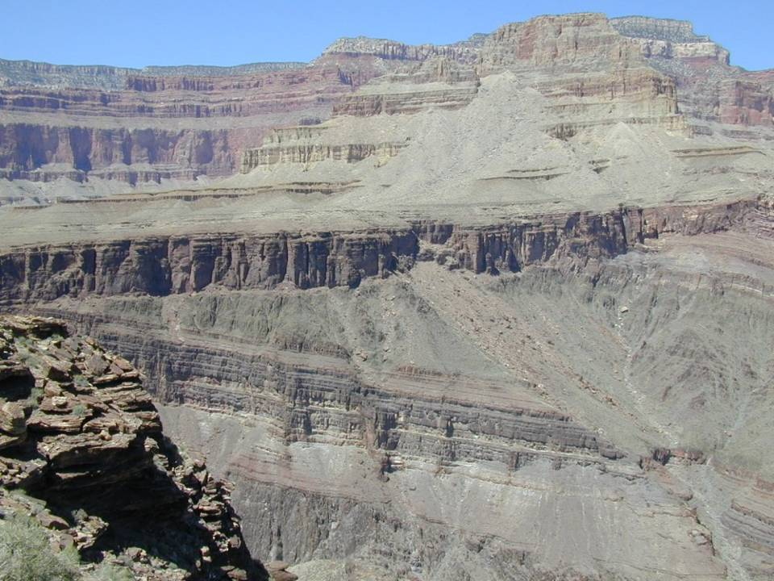
Angular unconformity?
Disconformity?
Nonconformity?
Notes:
What kind of unconformity is it?

Slide 9
Angular unconformity
Notes:
Obviously it’s angular, right?

Slide 10
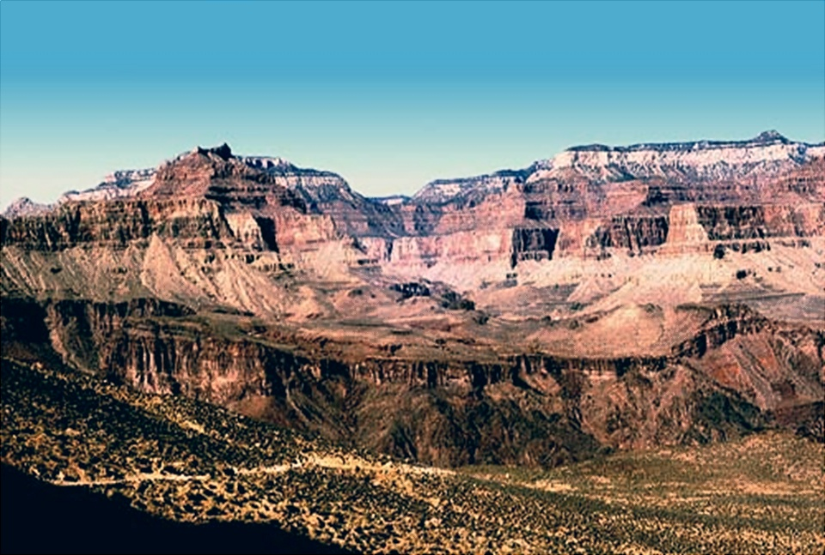
Shinumo Quartzite “islands”
Tapeats Sandstone
Grand Canyon Supergroup
Notes:
In certain places some of the Proterozoic Grand Canyon Supergroup rocks below the unconformity protrude through the Paleozoic rocks above the unconformity. This tends to happen with the Proterozoic Shinumo Quartzite because it is such a hard rock that when Late Proterozoic erosion occurred on the Grand Canyon Supergroup, small hills remained on the quartzite. When the Tapeats Sandstone was deposited, it did not completely cover up these hills, so the quartzite protrudes like “islands” out of an “ocean” of Tapeats Sandstone.

Slide 11
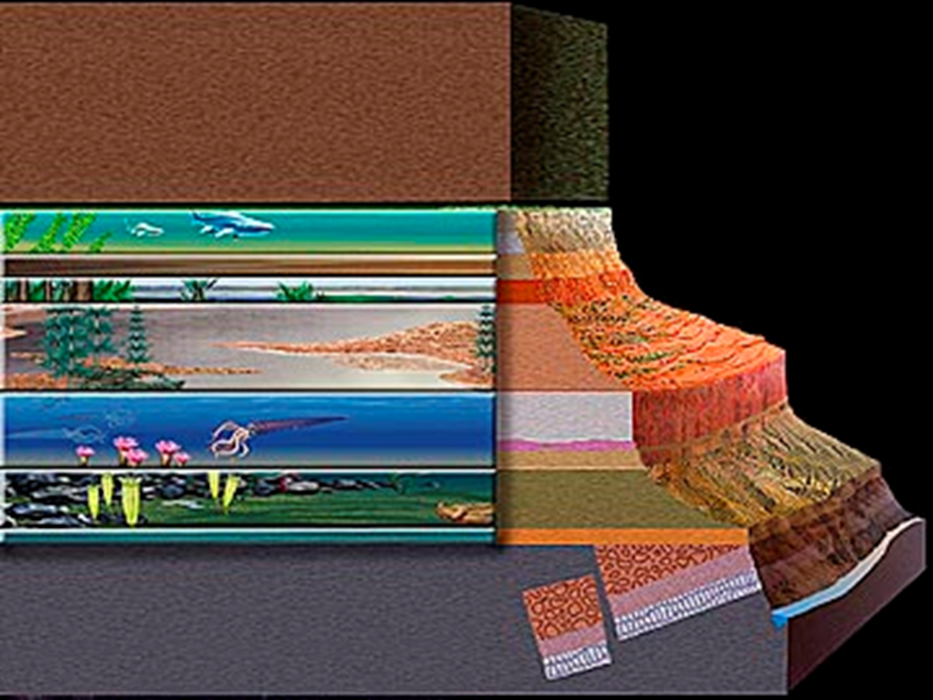
The Great Unconformity
Notes:
Above the Great Unconformity lies the “classic” Grand Canyon sequence of 10 sedimentary units that tell the tale of varied and intriguing primitive worlds.

Slide 12
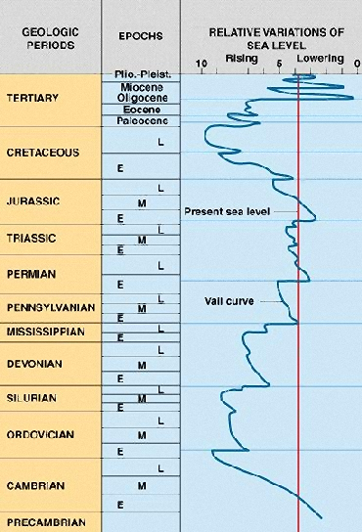
EVENTS
Pangaea
Pannotia
Notes:
Depositional environments varied markedly through time because sea and land levels rose and fell as the Supercontinent Cycle unfolded.

Slide 13
EVENTS
Pangaea
Grand Canyon Sequence
Pannotia
Notes:
The Grand Canyon Sequence is mostly Paleozoic and records the depositional events that occurred on a divergent continental margin as Pannotia broke apart and Pangaea formed.

Slide 14
EVENTS
Pangaea
Pannotia
Notes:
The general pattern of sea level change in the Paleozoic shows four periods when sea level rose …

Slide 15
EVENTS
Pangaea
Orogeny
Orogeny
Slower Sea Floor Spreading
Orogeny
Orogeny
Rapid Sea Floor Spreading
Sediment Transfer into Oceans
Pannotia
Notes:
… followed by four periods when sea level dropped.

Slide 16
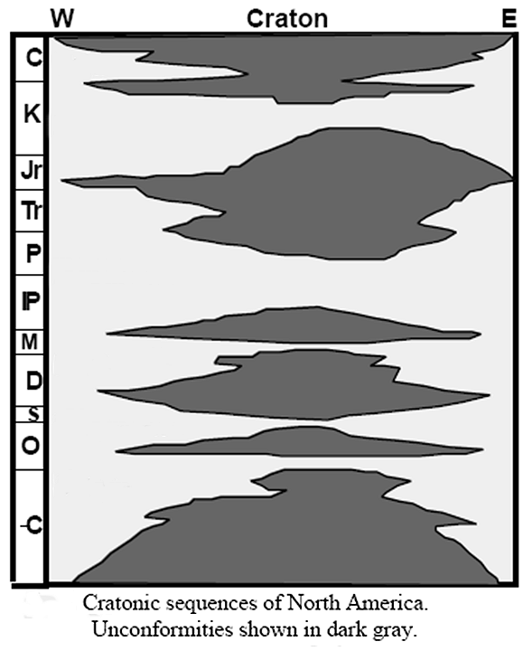
Deposition
Notes:
Each time the sea rose, shorelines shifted inland, towards the center of the craton and deposition (shown in white here) covered more of the craton.

Slide 17
Deposition
transgressions
Notes:
Such events are called transgressions.

Slide 18
Unconformities
(no sediment record)
Notes:
Each time the sea fell, shorelines shifted away from the center of the craton – leaving it exposed to erosion.

Slide 19
Unconformities
(no sediment record)
regressions
Notes:
Such events are called regressions.

Slide 20
4th
4th
Cratonic sequences
3rd
3rd
2nd
2nd
1st
1st
Notes:
The sedimentary record of each transgression / regression pair is known as a sedimentary cycle, or more specifically, a cratonic sequence if the sediments deposit on a craton. Four such sequences are recorded in the Grand Canyon Paleozoic section. There are also Mesozoic and Cenozoic cratonic sequences in North America, but they are not relevant to our study at this time, because they are not preserved in the Grand Canyon, nor did they form when western North America was a DCM.

Slide 21
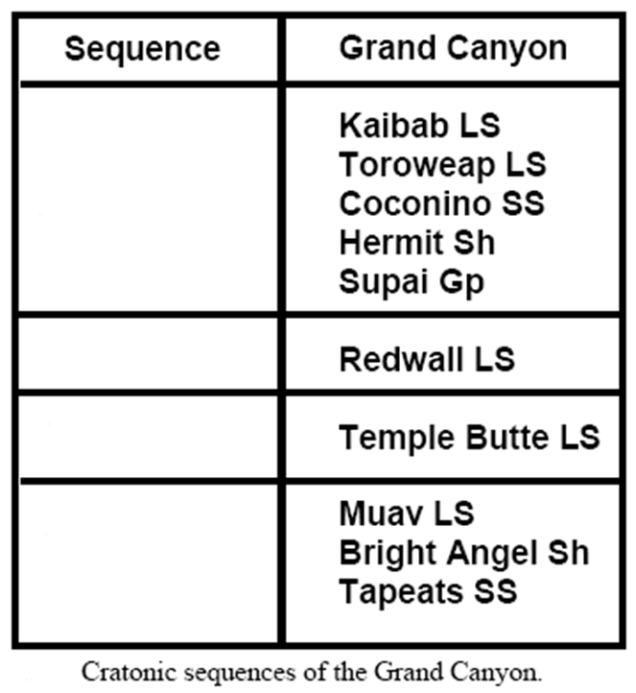
KNOW THE CANYON’S HISTORY
STUDY ROCKS TRULY MADE BY TIME
4th
3rd
2nd
1st
Notes:
The four Paleozoic cratonic sequences are represented by ten formations in the Grand Canyon, the first letter of which is found in the handy mnemonic: “Know The Canyon’s History Study Rocks Truly Made By Time”. Let’s take a closer look at the first sequence – the “Made By Time” group.

Slide 22
The First Transgression
Notes:
The first time the shoreline advanced toward land was the most profound.

Slide 23
EVENTS
Pangaea
Rapid Sea Floor Spreading
Sediment Transfer into Oceans
Pannotia
Notes:
It roughly corresponds to the Cambrian period, when sediment transfer into the oceans from the peneplanation of Pannotia and rapid sea floor spreading due to its subsequent rifting, combined to produce what might be described as the greatest transgression in earth history.

Slide 24
Notes:
By the Middle Cambrian, the Grand Canyon area was awash in shallow seas.

Slide 25
Notes:
A sandy shoreline lay to the east …

Slide 26
Notes:
… while mud settled in slightly deeper water …

Slide 27
Notes:
… and lime accumulated near the edge of the continental shelf. These of course are the classic sediments of a divergent continental margin, and when lithified became the rocks sandstone, shale and limestone.

Slide 28
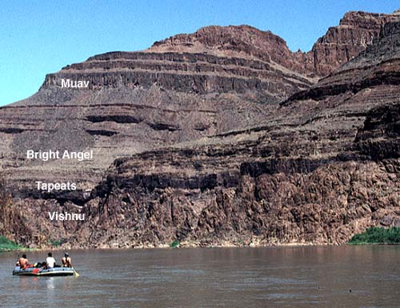
Notes:
The Tapeats is the sandstone, the Bright Angel is the shale, and the Muav is the limestone. Remember “Made By Time”. Sandstone is on the bottom because as sea level rose, a sandy shoreline was the first marine depositional environment to replace the peneplain eroded onto the Proterozoic basement. Sandy shorelines were replaced by deeper water mud and lime deposits as the depth and distance to the shore increased.

Slide 29
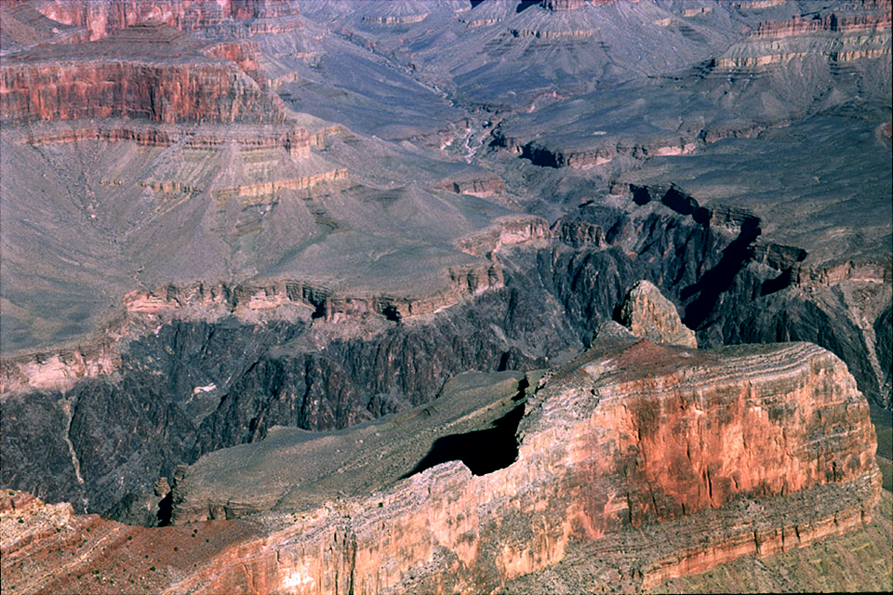
What kind of unconformity is it?
Tapeats Sandstone
Vishnu schist
Notes:
The Great Unconformity is most clearly seen between the light colored Tapeats Sandstone and the much darker Vishnu schist, but because the Vishnu schist is a metamorphic rock, such portions of the Great Unconformity are not considered angular unconformities. What kind of unconformity is this?

Slide 30
What kind of unconformity is it?
Nonconformity
Notes:
Did all you nonconformists get it right?

Slide 31
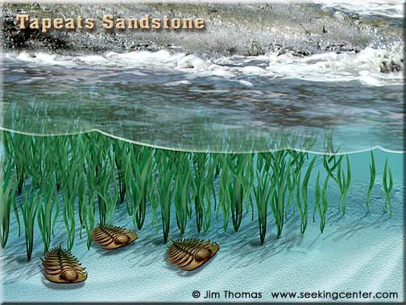
Notes:
Here is an artist’s conception of the near shore environment represented by the Tapeats Sandstone. The critters are trilobites – the quintessential Cambrian fossil.

Slide 32
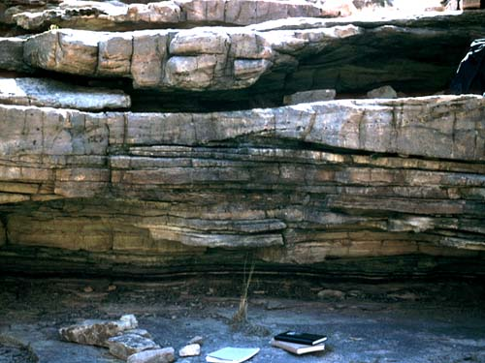
Tidal lenses
Notes:
That the Tapeats Sandstone was deposited in a shallow, near-shore environment, is evidenced by lens-shaped bodies created by tidal currents, …

Slide 33
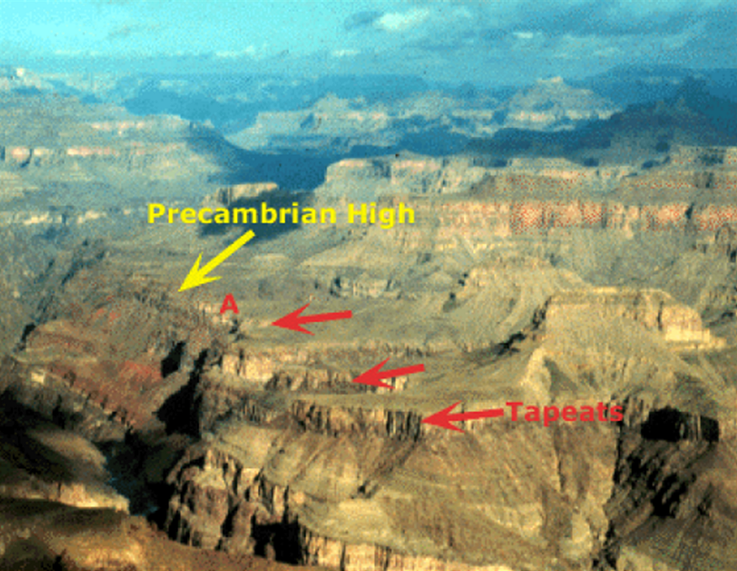
Notes:
… and that it pinches-out against resistant Proterozoic topographic highs or islands (notice how thin the unit is at “A”) …

Slide 34
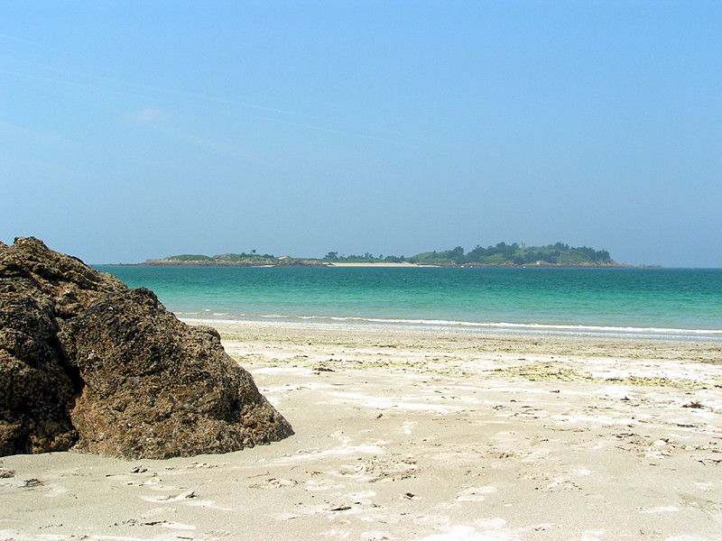
Notes:
… just like modern sandy beaches do.

Slide 35
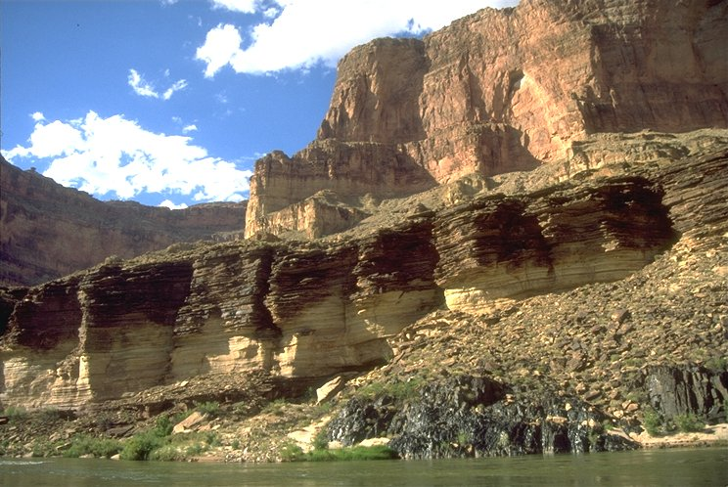
Tapeats Sandstone
Notes:
Notice the dark, shaly rock above the Tapeats Sandstone.

Slide 36
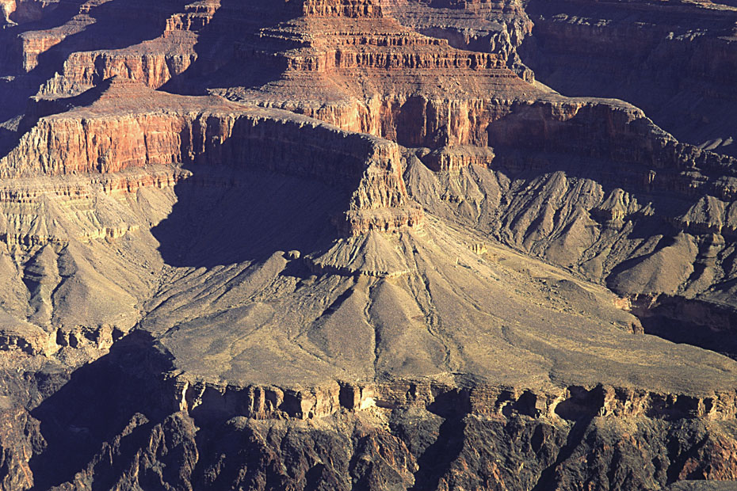
Name?
Notes:
Name that shale!

Slide 37
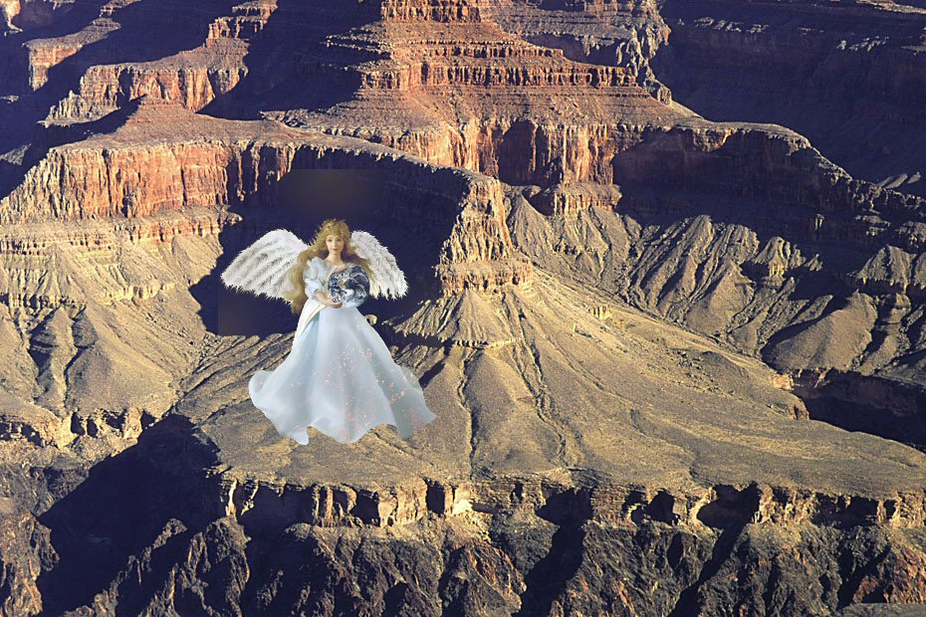
(hint)
Notes:
Here’s a subtle hint.

Slide 38
Bright Angle Shale
Notes:
You are truly amazing! How do you do it?!

Slide 39
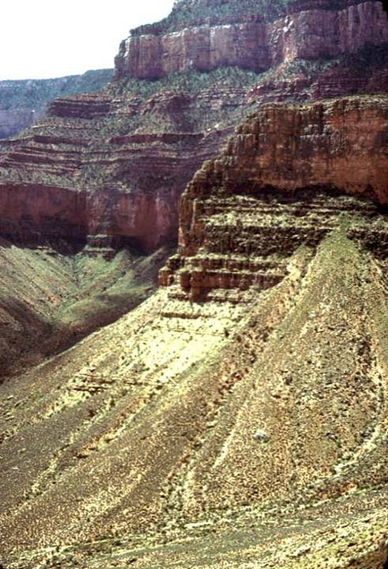
Typical exposures
Bright Angel Shale
Notes:
Because the Bright Angel Shale is weak and easily eroded, it can not maintain cliffs like the more durable sandstone and limestone units.

Slide 40
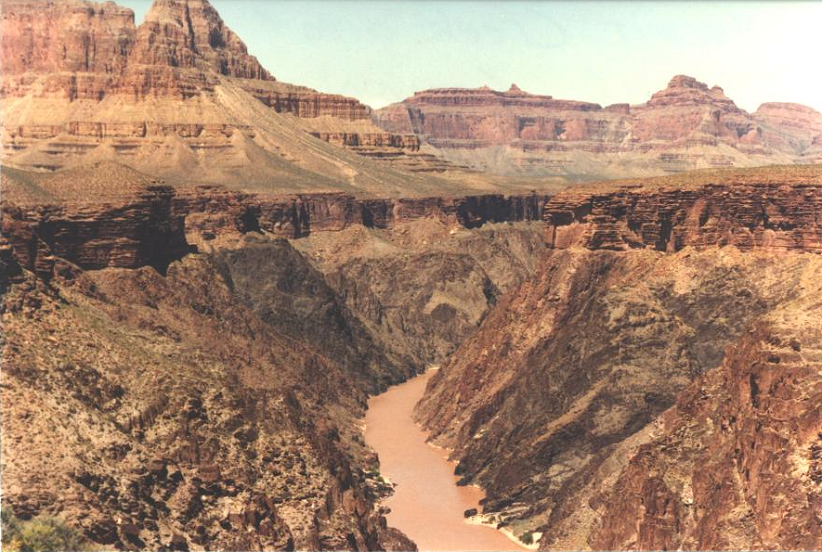
Redwall
Muav
Bright Angel
Tonto Platform
Tapeats
Notes:
Instead, it forms the conspicuous, broad shelf above the Inner Gorge known as the Tonto Platform.

Slide 41
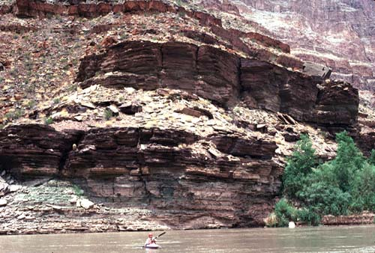
Good exposures where rapidly eroded.
Notes:
Good exposures only occur on the Lower Grand Canyon, where the Bright Angel Shale is in contact with the Colorado River which continuously removes the rock as fast as it disintegrates.

Slide 42
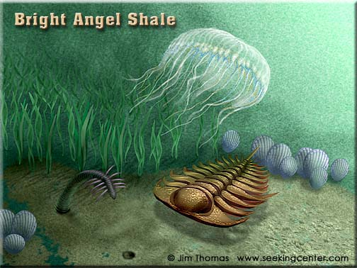
Notes:
Deposited in a shallow, muddy sea, more offshore than the Tapeats Sandstone, the Bright Angle Shale contains a correspondingly different fossil assemblage which includes worm burrows, brachiopods and jellyfish in addition to the requisite Cambrian trilobites.

Slide 43
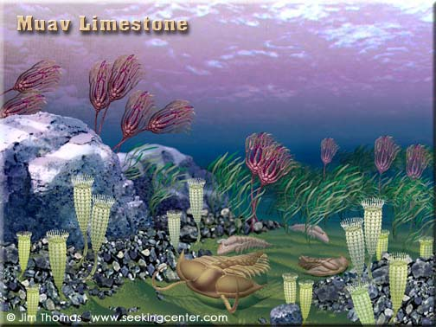
Notes:
The culmination of the first transgression is represented by the Muav Limestone. Now that the Cambrian shoreline had reached it’s furthest inland position, the Grand Canyon region was now perhaps 300km from that shoreline in relatively deep water, where very little land-derived clastic sediment existed. In these clear ocean waters shell-building creatures flourished and limestone deposited.

Slide 44
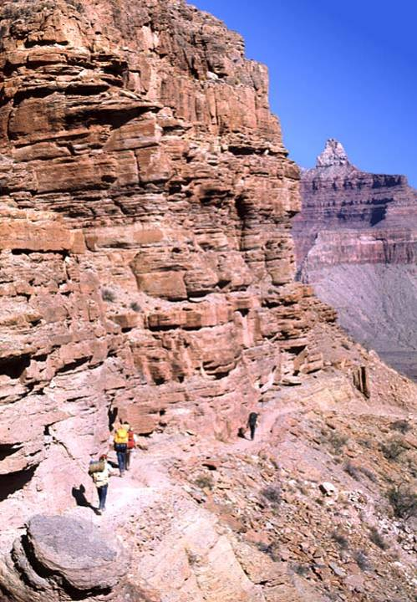
Muav Limestone on Kaibab Trail
Notes:
Here we see the Muav Limestone on the Kaibab Trail, the shortest path to the river from the south rim, and therefore very popular. Due to iron staining from the Redwall Limestone above, the Muav Limestone is generally much redder than it would be by its self.

Slide 45
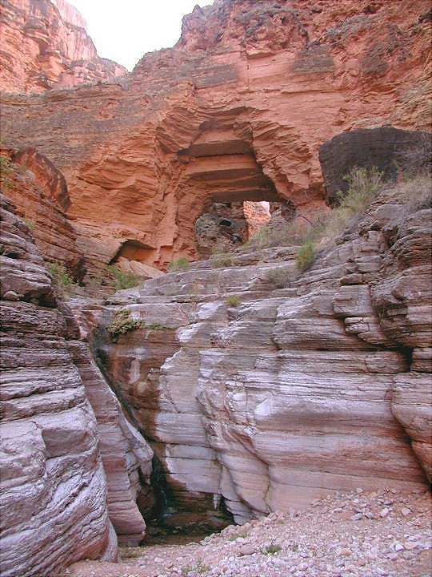
Muav Limestone at Royal Arch
Notes:
This is especially true at Royal Arch. The spectacular sight can only be reached by a far less accommodating trail than the Kaibab.

Slide 46
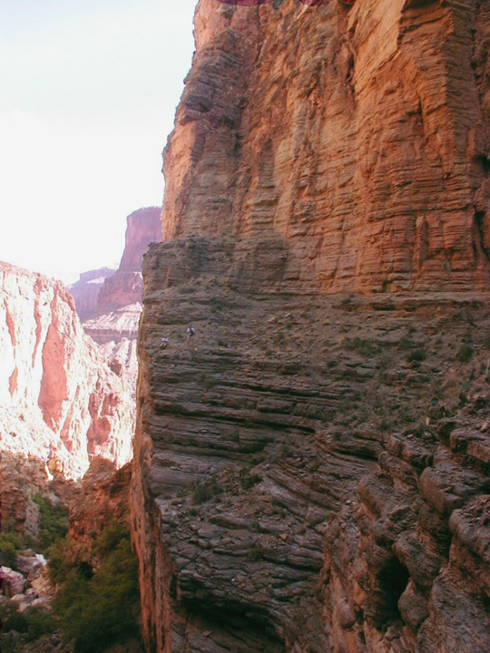
Notes:
In fact, the route to Royal Arch …

Slide 47
Notes:
… is considered one of the most difficult in the canyon …

Slide 48
Notes:
… and requires advanced scrambling and climbing skills.

Slide 49
Notes:
I can tell you with absolute certainty that I will never hike this trail!!!!

Slide 50
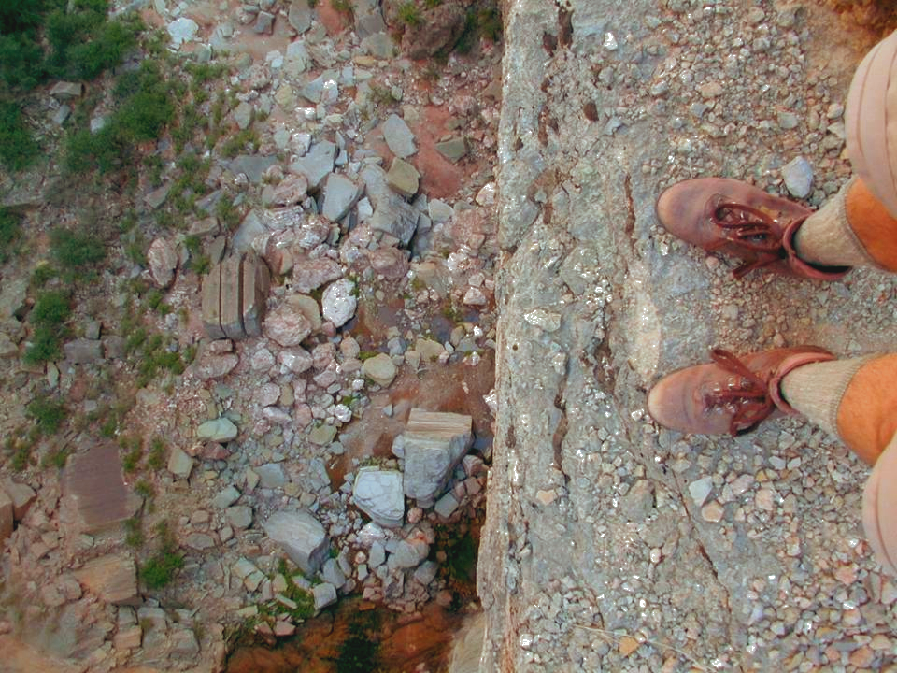
Notes:
The exposure is insane!

Slide 51
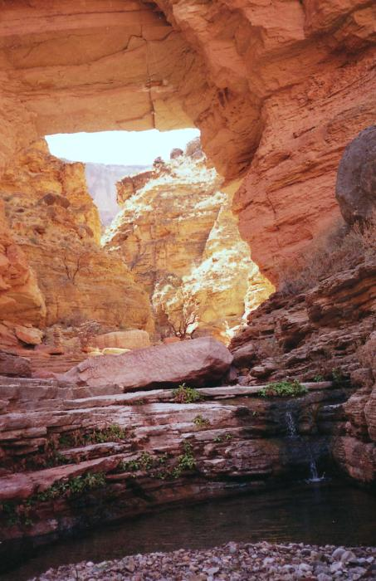
Notes:
Apparently the magnificent arch creates a cathedral-like setting that for skilled adventurers is worth the risk.

